Slide 1




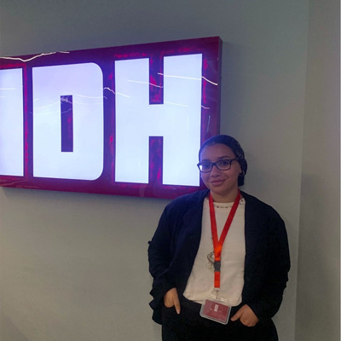
Stage-Wise Analysis of
Biomarkers: Impact of BMI, Age, Sex, and Race
Gastric Cancer
Nour Nahtay
Presenter
BIOMARKER DISCOVERY

Slide 2





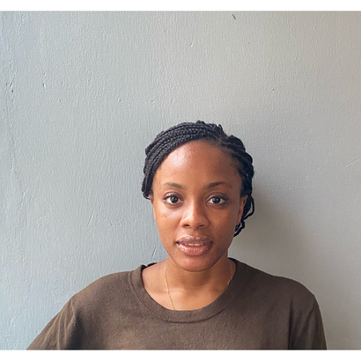
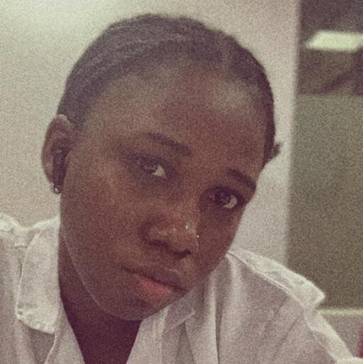
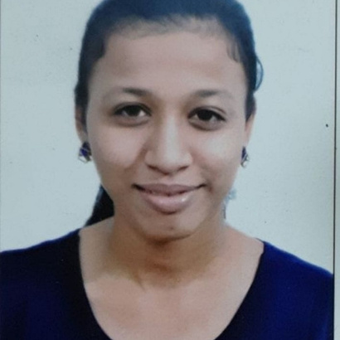

Meet The Team
01
02
03
04
Nour Nahtay
Merylin Ogunlola
Titilola Shittu
Rutuja Pangare
Team Lead
Co-Leader
Writing/ Quality Assurance
Code-Writing

Slide 3




So, What’s the Problem?
What are we attempting to solve?
Explore obseity as a risk factor for stomach cancer
1
Address the Lack of Race-Based studies
2
Understand the Anatomical Difference Between Sexes and their role in susceptibility
3

Slide 4


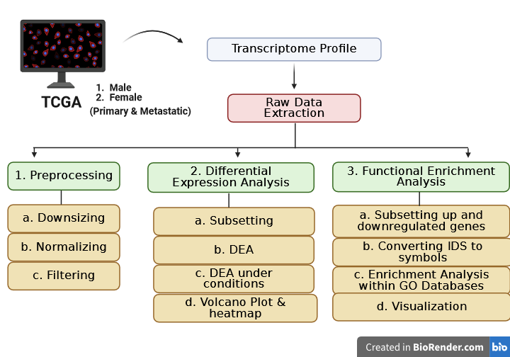
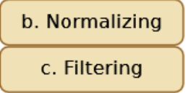
P
I
P
E
L
I
N
E

Slide 5


Predictions
We believe that these factors have significant effects on the biomarkers!

Slide 6




It Is
QA Time!
What do you have in mind?

